Slide 1
Contactotron: Contact Manager of the Future
Group 19

Slide 2
Team Members and Roles
Thomas (Tommy) Greco – Database/Project Manager
Jonathon (Jon) Bell - API
Troy Crawford - API
Steven Hudson – HTML/JS
Hannah Main – API
Chedlyne (Chey) Valmyr – HTML/JS

Slide 3
Technology Used
LAMP Stack (Linux, Apache, PHP, MySQL)
GoDaddy w/ CPANEL
Discord
GitHub
ARC API Testing
Font Awesome
JQuery/DataTables

Slide 4
Things That Went Well
Group members were easy to work with.
Very supportive with answering questions.
Spread out jobs nicely to people who had some prior experience.
Everyone was willing to learn to complete the tasks.

Slide 5
Things That Didn’t Go Well
Meetings took some time to get started with tardiness.
Slow start getting organized.
Datatables were a bit tricky to get set up.

Slide 6
DataTables
Don’t have to worry about paging.
Auto sorting.
Records viewed per page.

Slide 7

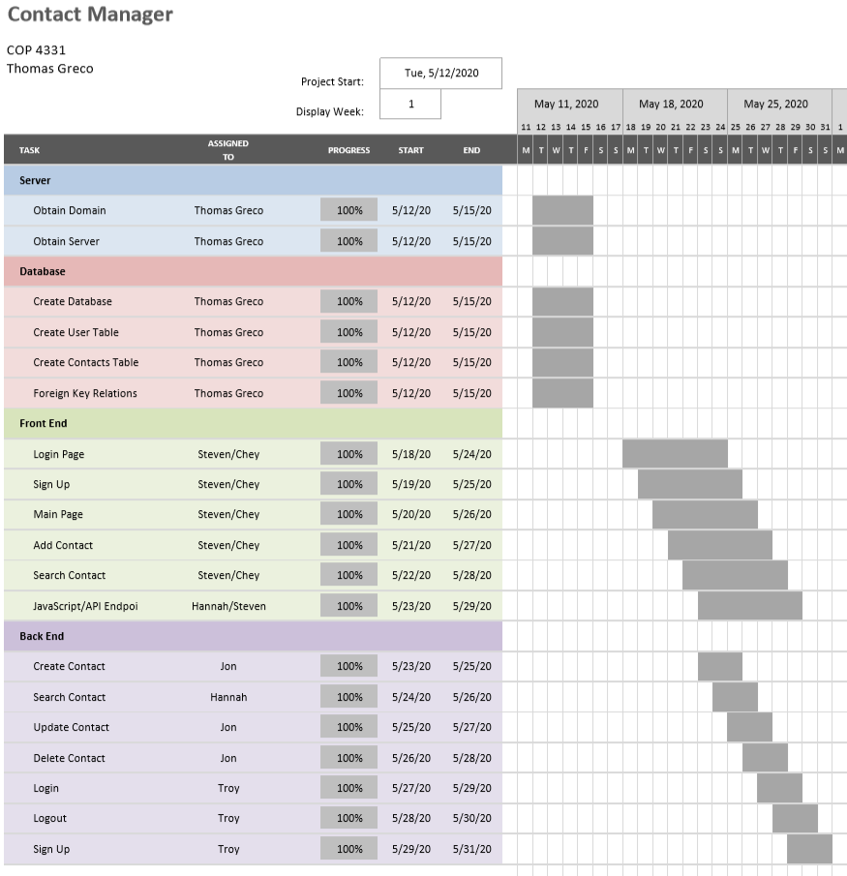
Gantt Chart

Slide 8
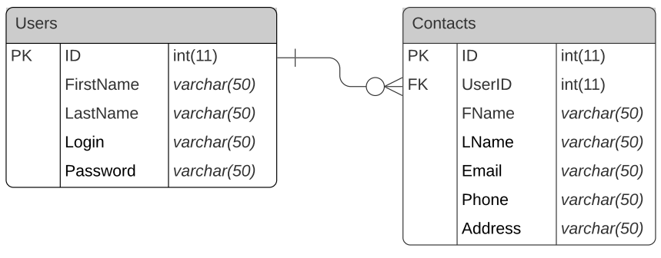
ERD

Slide 9
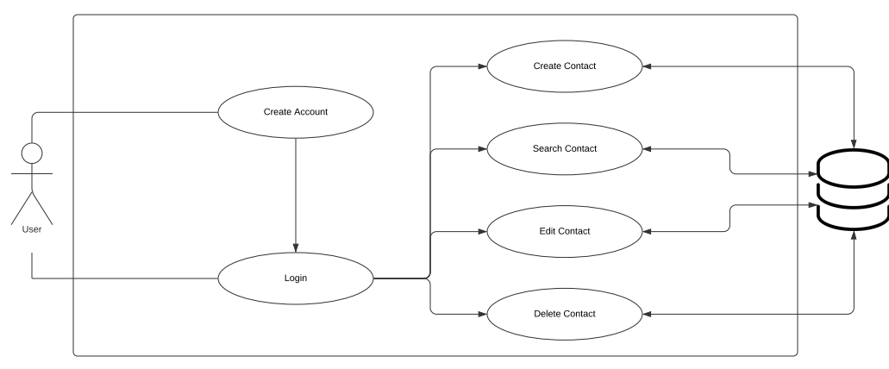
Use Case

